Slide 1
W. M. Boyd Elementary
GO Team
Business Meeting #2
Where we are – Where we’re going

Slide 2


Where We Are
Our strategic plan is the guide for the work we’re doing in the school. By monitoring the plan and ranking priorities, we can all work towards the common goals. Using the priorities in the strategic plan, the school leadership team developed a Continuous Improvement Plan (CIP) for the current school year.

Slide 3
Timeline for GO Teams
You are HERE
1
2
3
4
5
Fall 2021
GO Team Developed 2021-2025 Strategic Plan
Summer 2024
School Leadership completed Needs Assessment and defined overarching needs for SY24-25
August 2024
School Leadership completed 2024-2025 Continuous Improvement Plan
Sept. – Dec. 2024
Utilizing current data, the GO Team will review & possibly update the school strategic priorities and plan
Before Winter Break
GO Team will take action (vote) on the rank of the strategic plan priorities for SY25-26 in preparation for budget discussions.

Slide 4
Discussion Items
Current Strategic Plan
Georgia Milestones Math Data
(Embargoed)
Continuous Improvement Plan
Needs Assessment
SMART GOALS
Action Plan
Strategic Plan Alignment & Update

Slide 5
Current
Strategic Plan
2021-2025

Slide 6
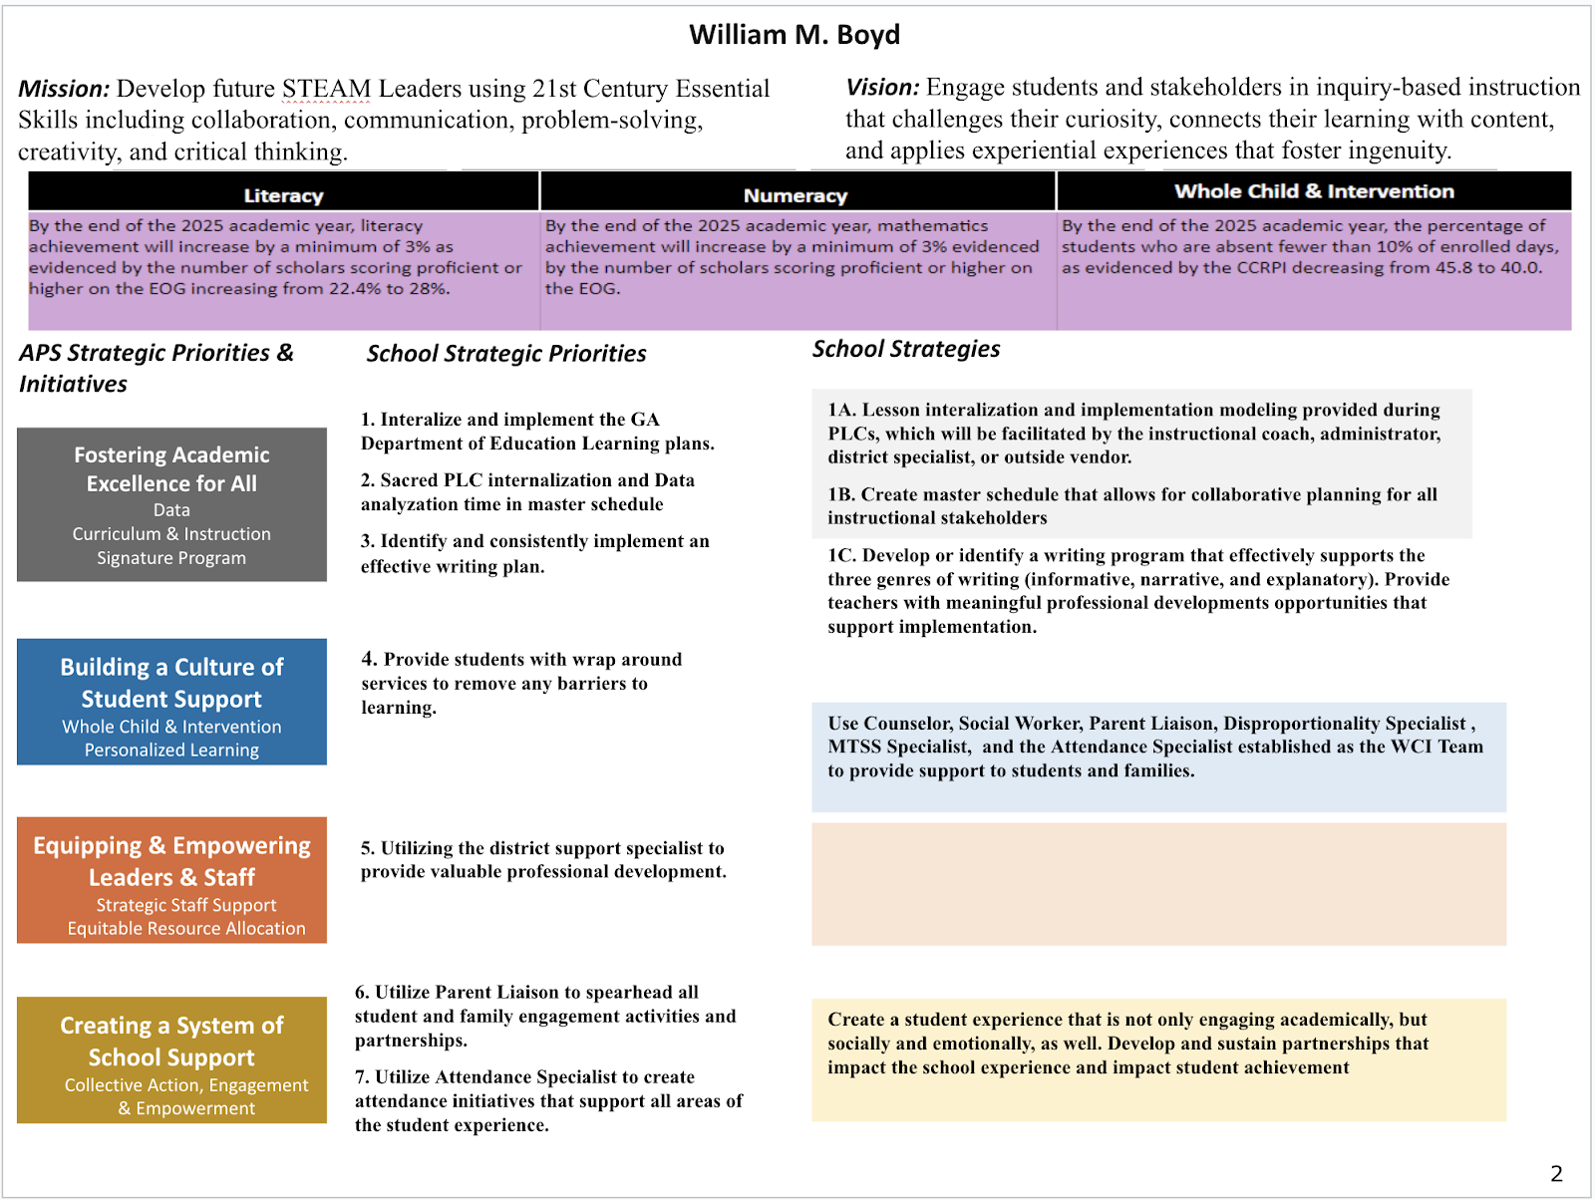
School Name
Mission
Vision
SMART Goals
TBD
TBD
TBD
TBD
APS Strategic Priorities & Initiatives
School Strategic Priorities
School Strategies
1A. tbd
1B. tbd
1C. tbd
Fostering Academic Excellence for All Data
Curriculum & Instruction Signature Program
Before Presenting to your GO Team:
Insert School’s Current Strategic Plan
Building a Culture of Student Support
Whole Child & Intervention Personalized Learning
TBD: tbd
TBD: tbd
4.
Equipping & Empowering Leaders & Staff
Strategic Staff Support Equitable Resource Allocation
6.
7.
TBD: tbd
Creating a System of School Support
Strategic Staff Support
Equitable Resource Allocation
8.
9.
TBD: tbd
14

Slide 7
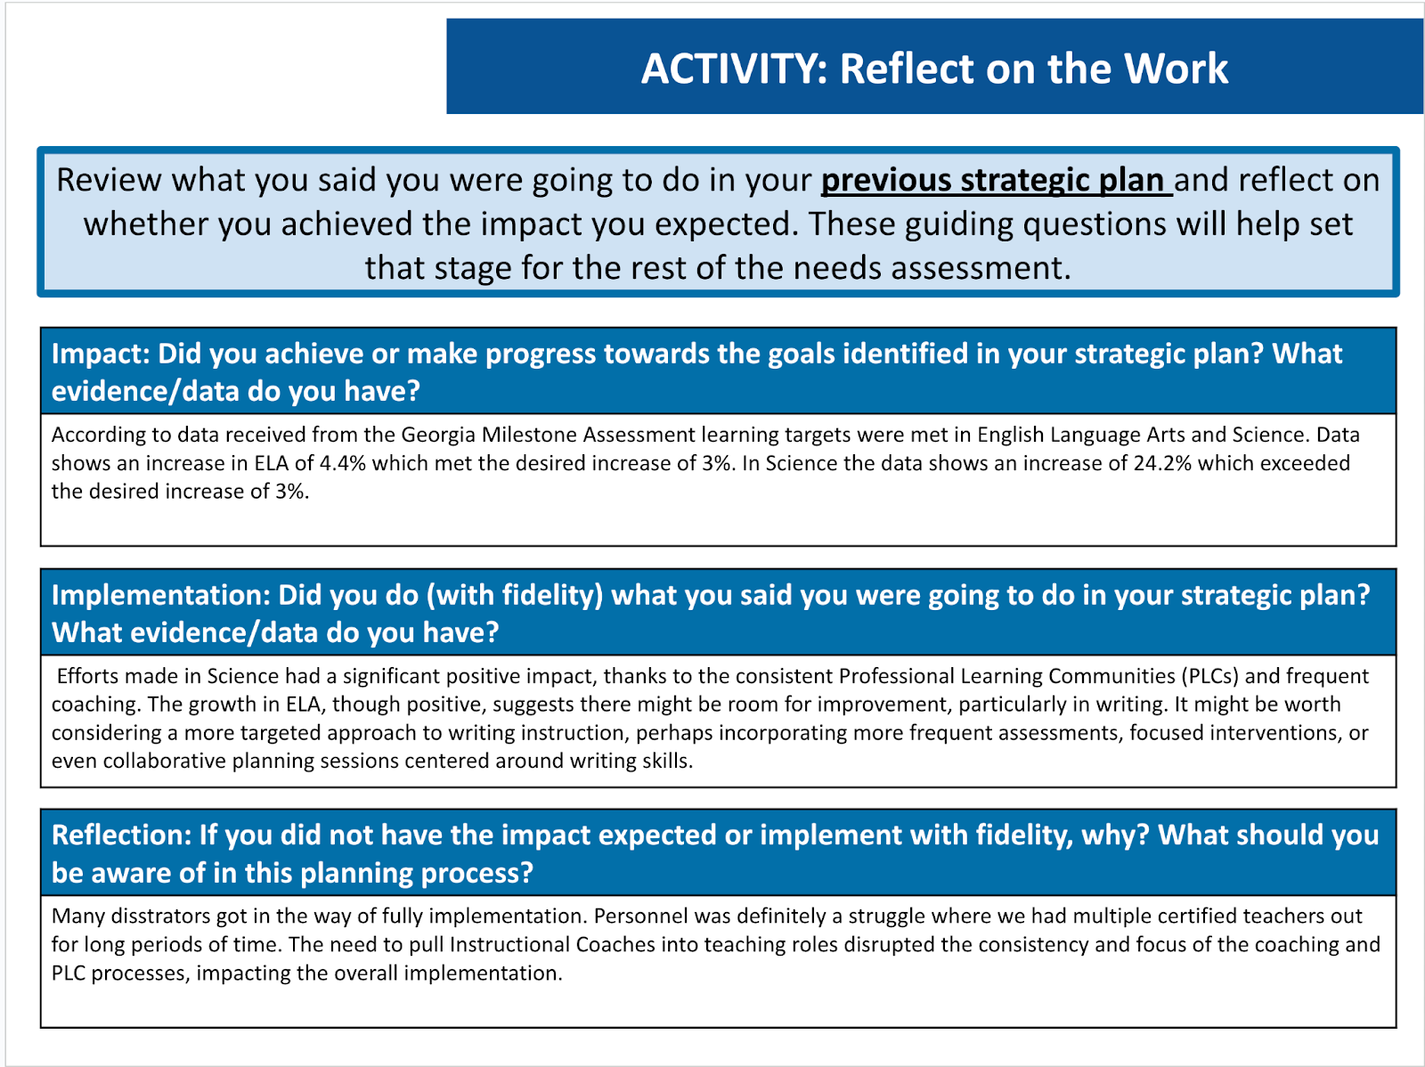
Data

Slide 8
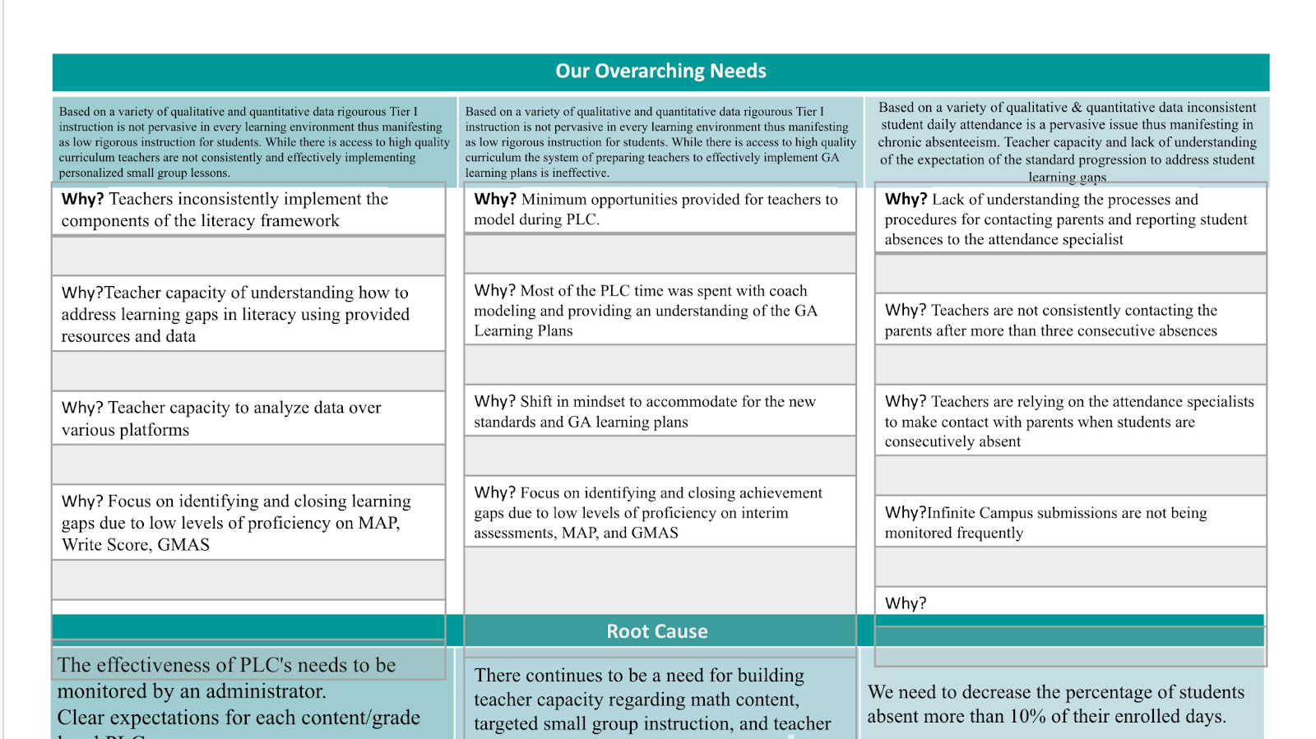

Slide 9
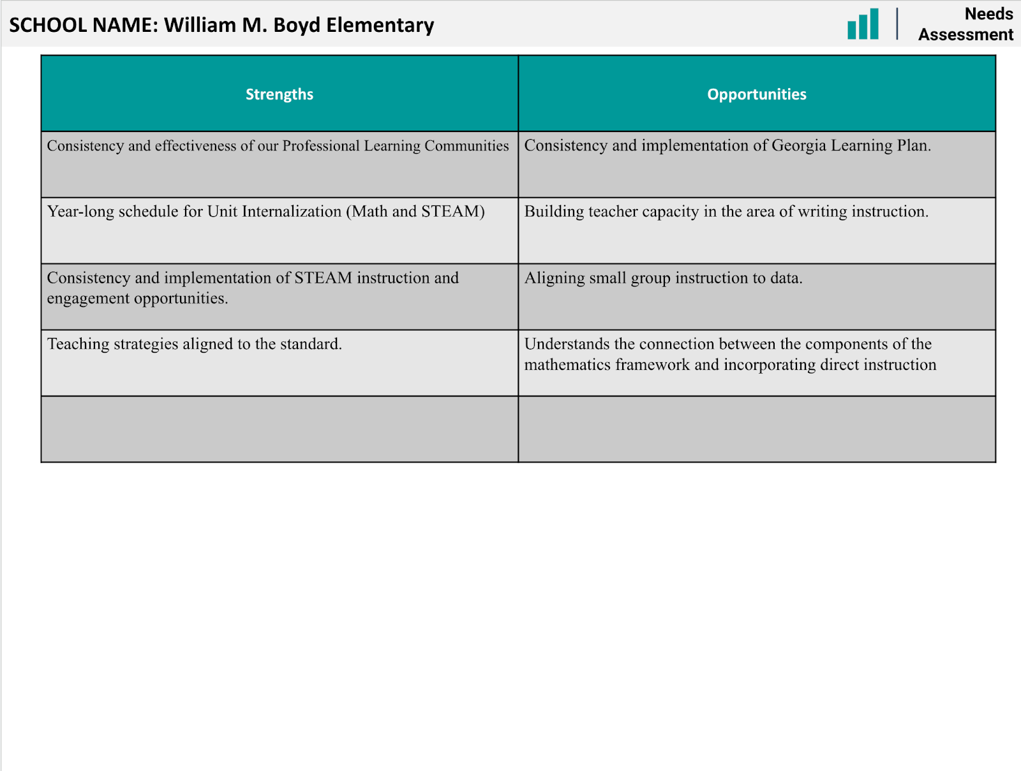

Slide 10

Strategic Plan
Priority Ranking

Slide 11
GA MILESTONES MATH RESULTS
Math GMAS data is embargoed until December 6, 2024. We will address the data at our next GO Team meeting.
Fall MAP Assessment is scheduled for December 3-4 , 2024.

Slide 12
Continuous Improvement Plan

Slide 13
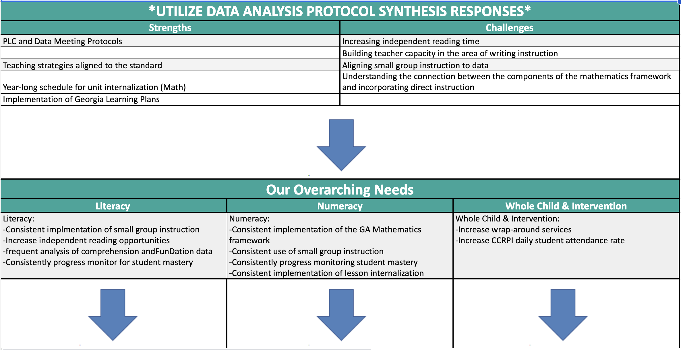
Notes:
Notes for School CIP Teams: After completing your Comprehensive Needs Assessment ( data protocol), you will come here and identify some strengths and opportunities/challenges you have observed from the data. The priority areas are Literacy, Numeracy, and Whole Child & Student Support. Identify an overarching need for each area. Formulate a problem statement for each area. Make sure the problem statement meets the criteria. Refer to your CIP resources.

Slide 14
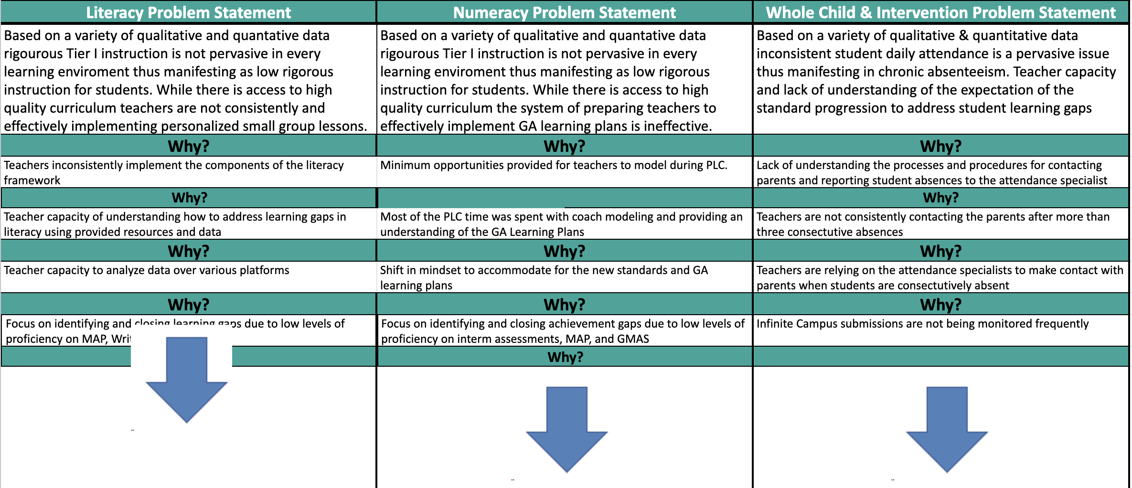

Slide 15
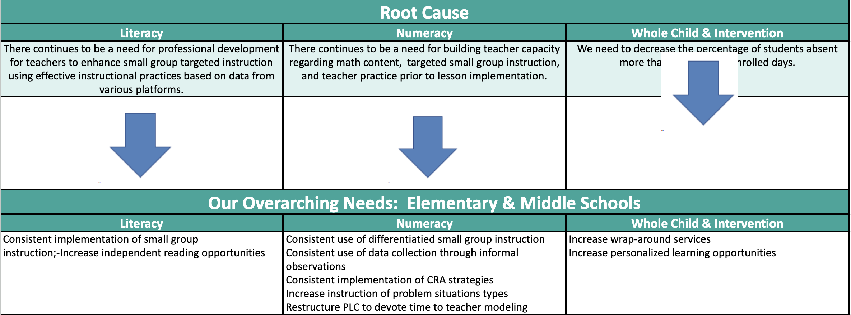

Slide 16
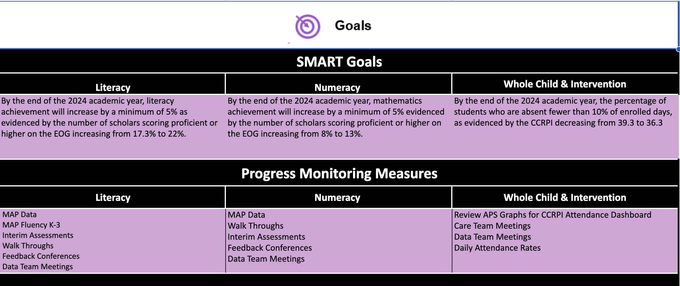

Slide 17
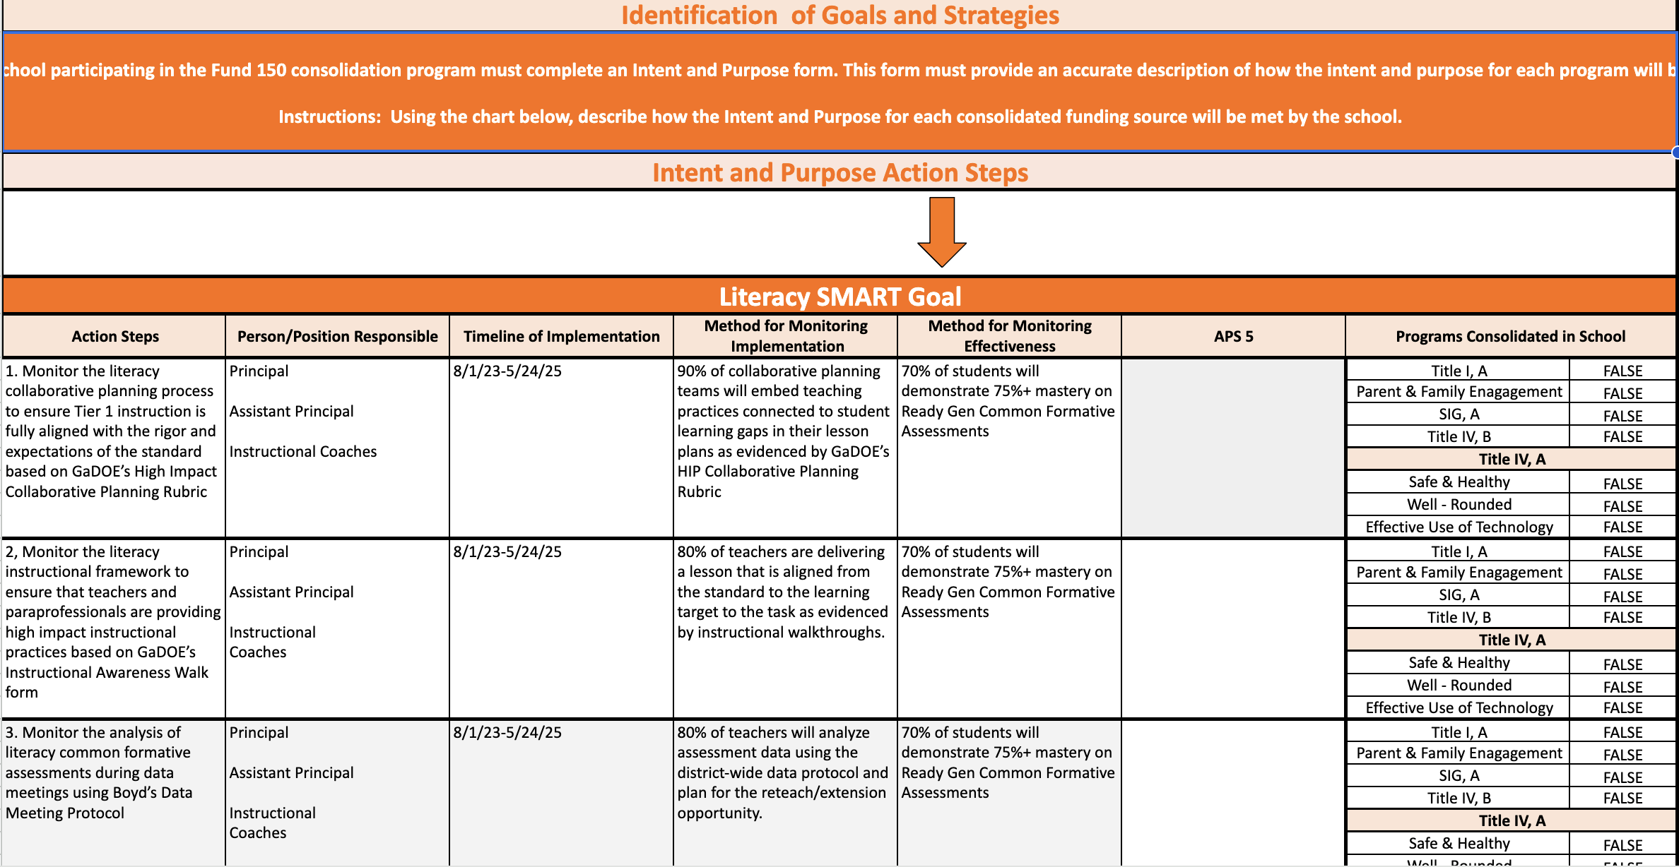

Slide 18
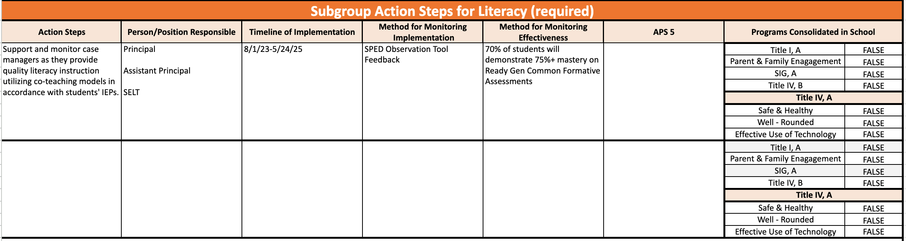

Slide 19
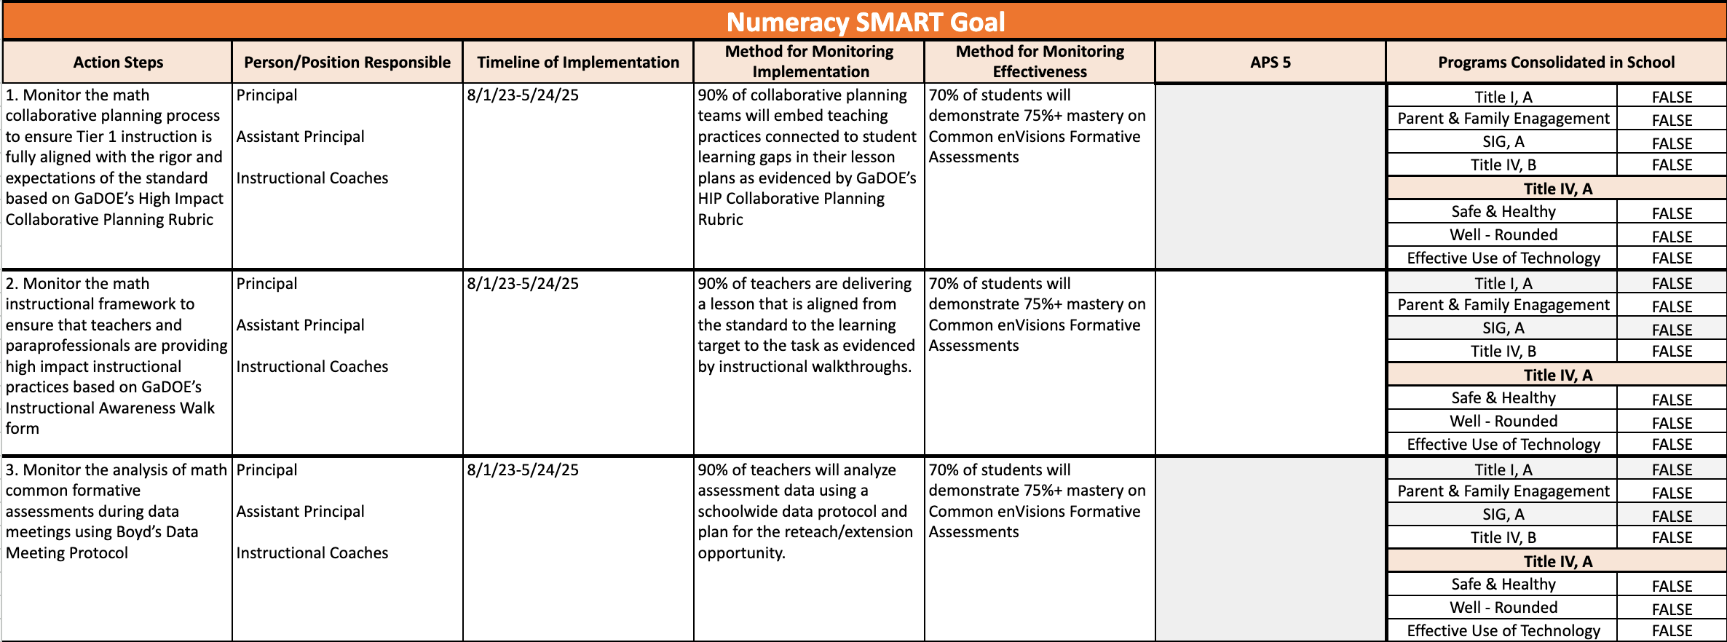

Slide 20
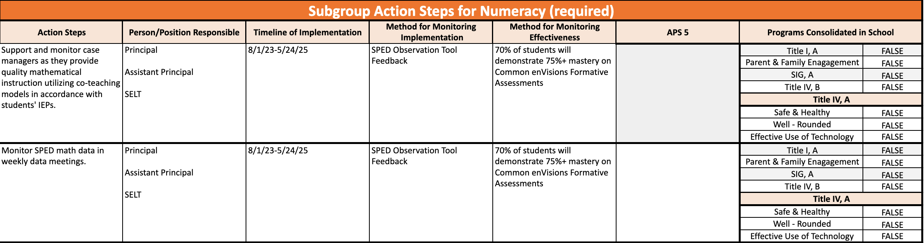

Slide 22
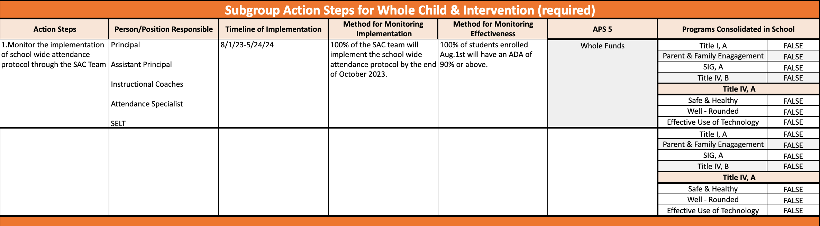

Slide 23
GO Team
Activity
&
Discussion
GO TEAM DISCUSSION: Review the priorities and goals in your strategic plan and the information and goals CIP. Reflect on if updates need to be made to the Strategic Plan.
Are all CIP Goals reflected in
our Strategic Plan Priorities?
If not, which CIP Goal(s) are missing and should be added to the Strategic Plan?

Slide 24

Updates to the
Strategic Plan
Enter all changes/updates to your plan – be sure to include accountability measures, as appropriate.

Slide 25
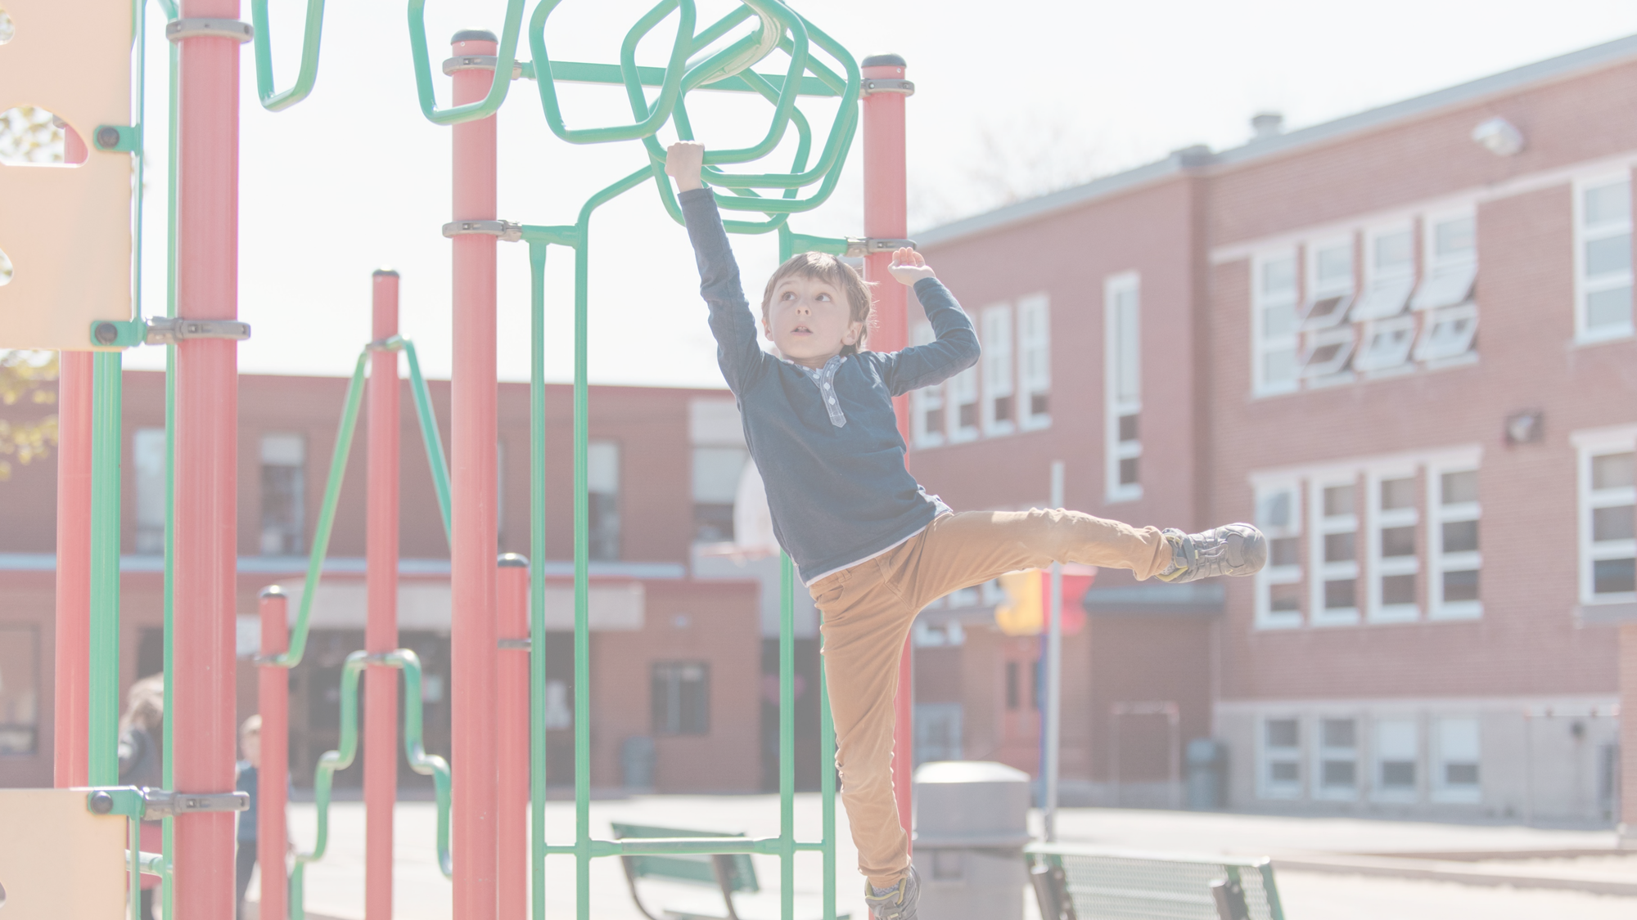
Strategic planning will help you fully uncover your available options, set priorities for them, and define the methods to achieve them.
Robert J. Mckain

Slide 26
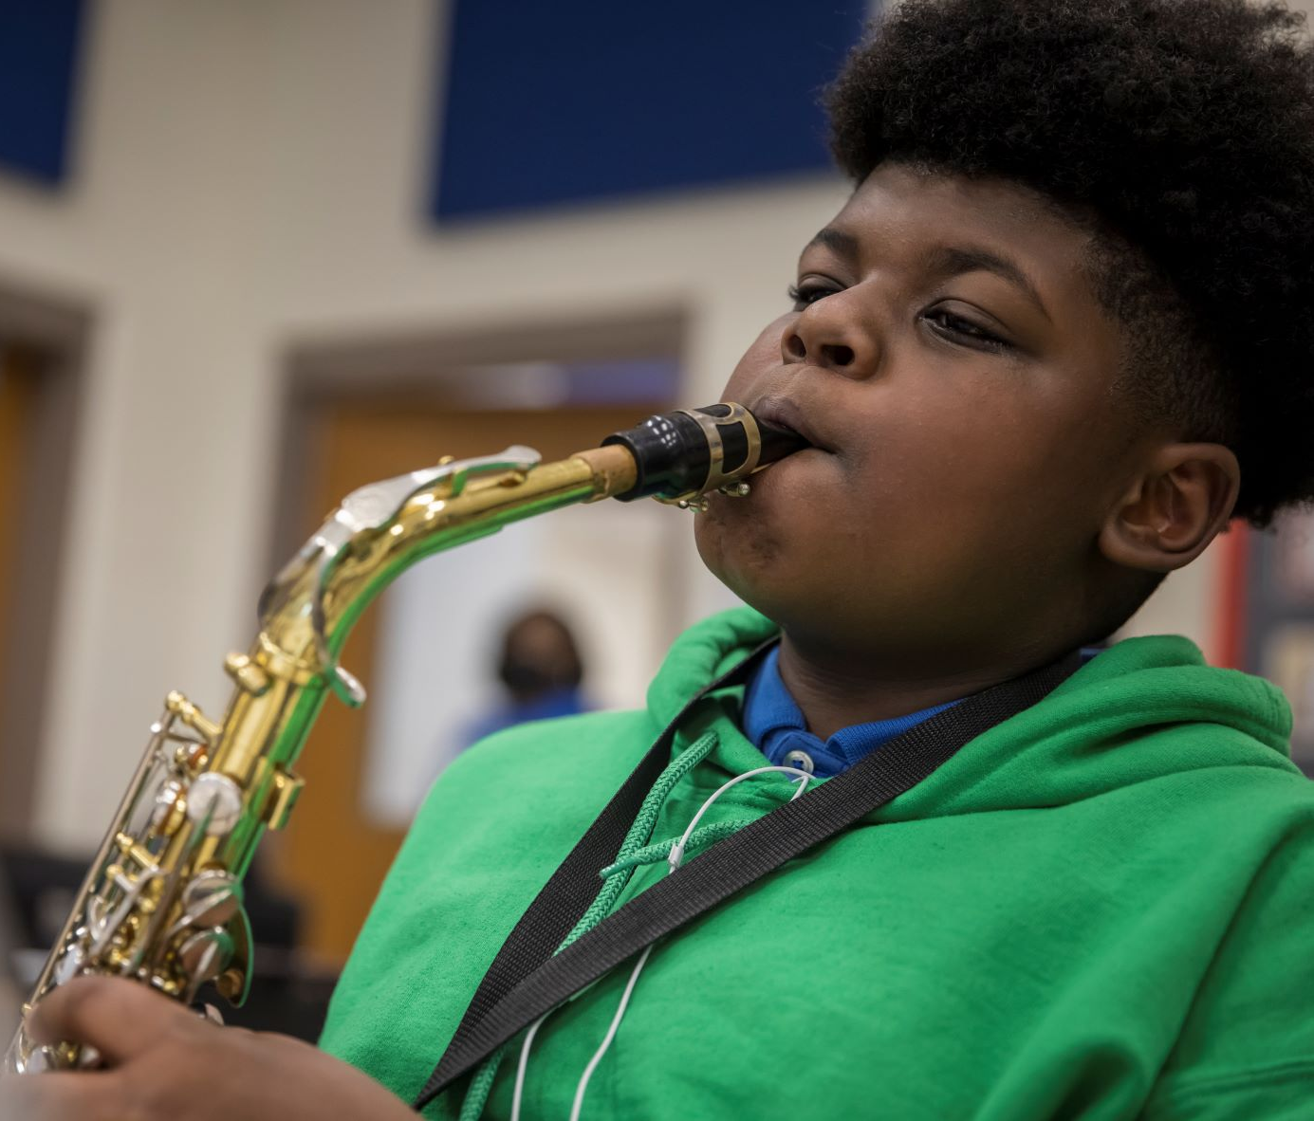

Where we’re going
At our next meeting(s) we will discuss how our data is aligning to our strategic plan and determine if we need to make any adjustments.
Before the end of Fall Semester, we will take Action (vote) on any updates to our strategic plan and the ranking our strategic priorities for the 2024-2025 school year.
Let me or the Chair know of any additional information you need for our future discussion.

Slide 27
Principal’s Report

Slide 28
Updates!!
Ruby Bridges Grant
Young Men of Boyd
Boyd Quarterly Perfect Attendance Celebration
Boyd Girls with Pearls

Slide 29
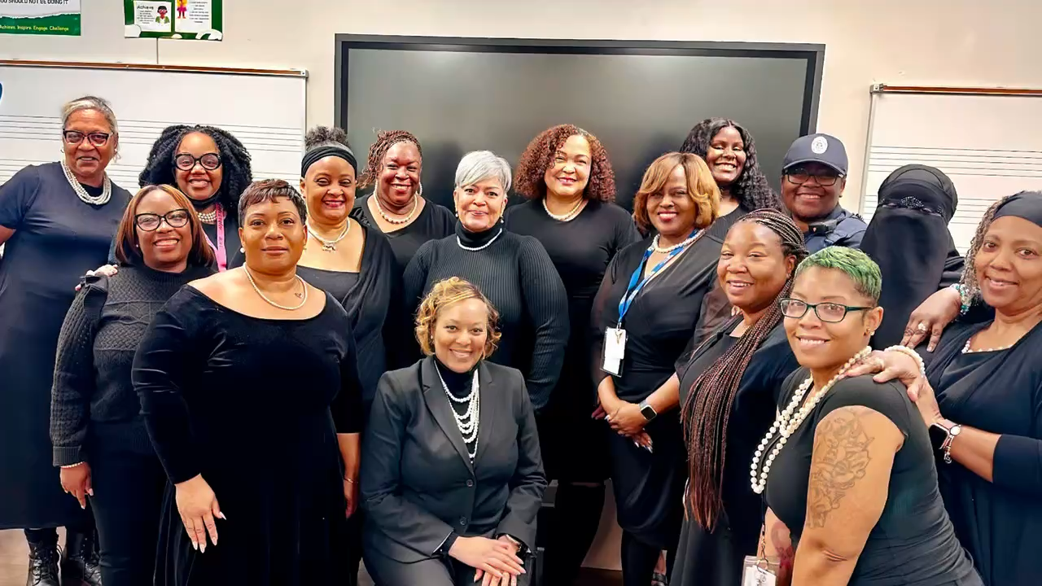
Girls with Pearls

Slide 30

Security Grant Update
Please update your GO Team on how the $45,000 security grant will be used at your school.

Slide 31
Thank you
Have a Wonderful Holiday Break!!

